Slide 1

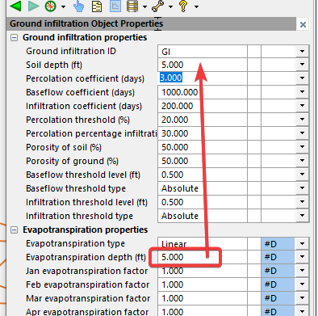






Evaporation
Soil Infiltration
Dmax
D
Dt
Percolation
Hnode
H
Ht2
Ht1
0 Elevation
Baseflow

Slide 2
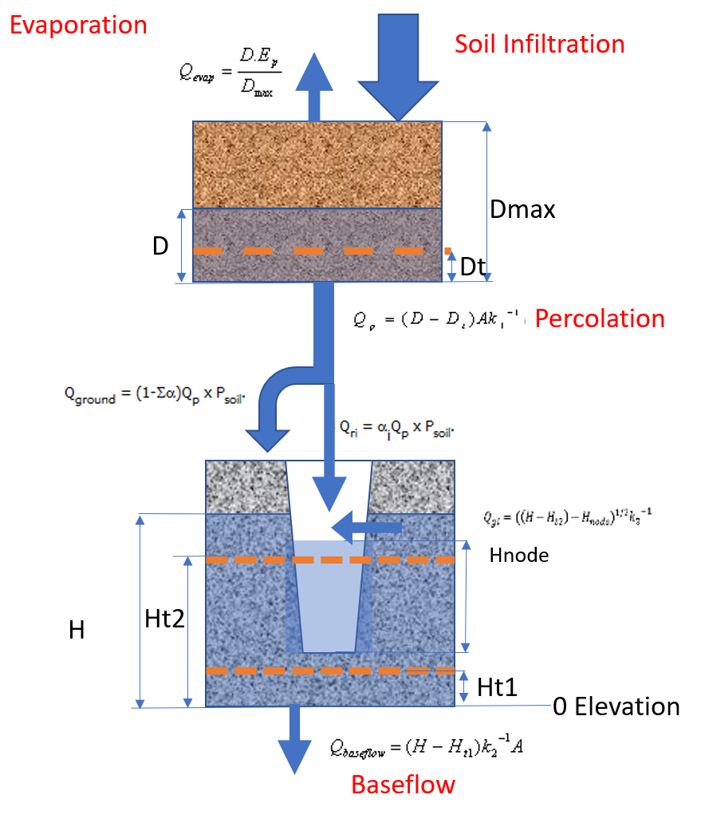
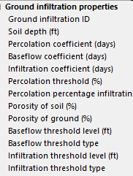
Dt=Dmax*(Threshold%)

Slide 3
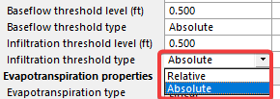
Ht1
Ht1, Ht2 are elevations in the above equations.
Ht2
Ht1, Ht2 threshold type = Absolute
H is measured from Elevation 0.
Ht1, Ht2 is measured relative to Elevation 0.
Ht1, Ht2 threshold type = Relative
H is measured in the same datum as the node
Ht1, Ht2 is measured relative to Node Invert
Relative
Absolute
Hnode
Ht2
Hnode
Ht1
H
Ht2
H
Ht1
0 Elevation
0 Elevation

Slide 4
Evaporation
Soil Infiltration
Dmax
D
Dt
By default, same as soil depth

Slide 5
I think Ht1, Ht2 is entered are the distances, not elevations
Ht1 = H – Ht1(eq)
Ht2 = H – Ht2(eq)
Node Invert: 200ft
Ht1 = 2ft
Ht2 = 5ft
Absolute
Ht1, Ht2 threshold type = Relative
H is measured in the same datum as the node
Ht1, Ht2 is measured relative to Node Invert
Hnode
H
Ht2
Ht1
Ht1, Ht2 threshold type = Absolute
H is measured from Elevation 0.
Ht1, Ht2 is measured relative to Elevation 0.
0 Elevation
Relative
Ht2
Hnode
Ht1
H
0 Elevation

Slide 6
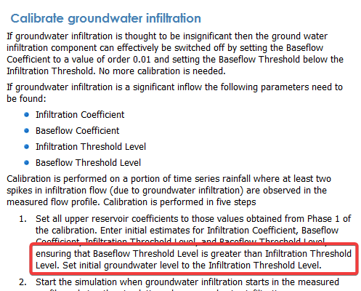
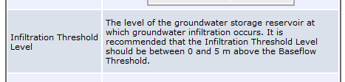

Questions: baseflow threshold level vs infiltration level?

Slide 7
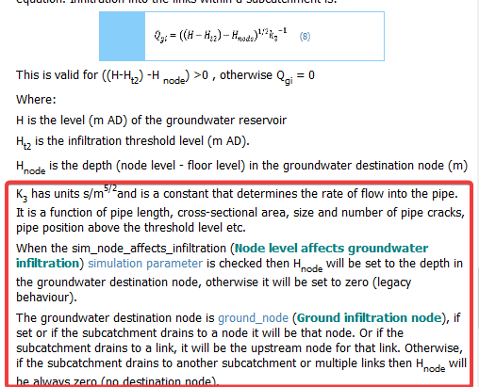
How is infiltration calculated?
Which value controls k3?

Slide 8
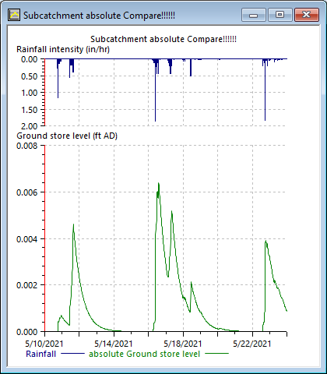
Why ground water level changes so small?

Slide 10
By default, same as soil depth

Slide 11
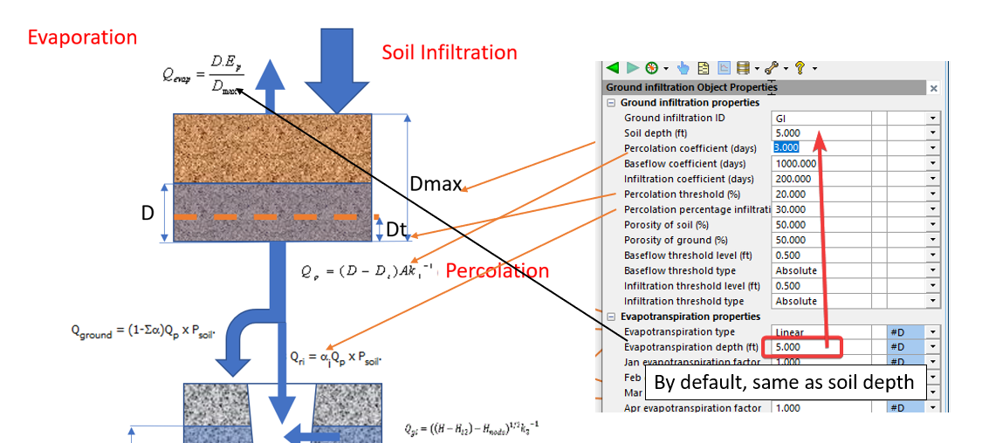
Soil store

Slide 12
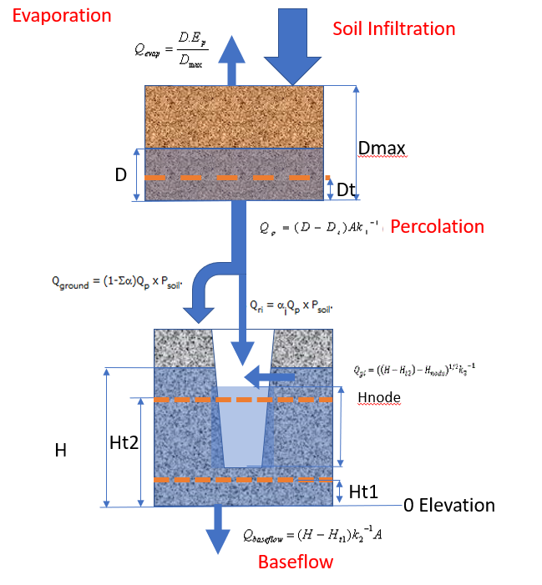
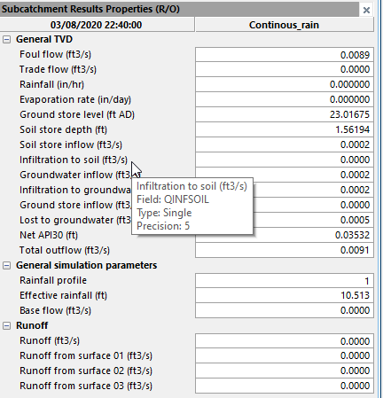
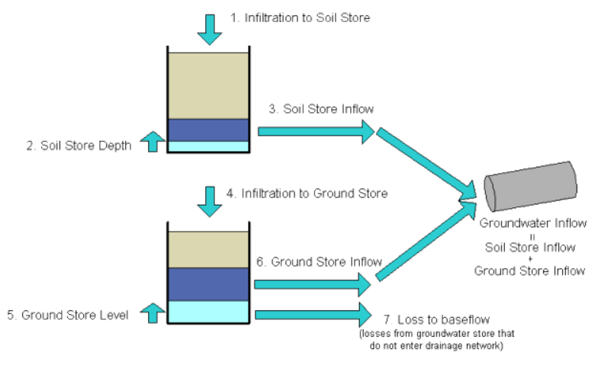
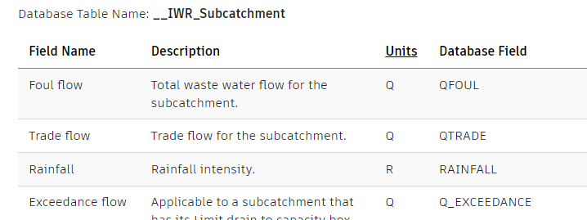
Results data field names

